Slide 1
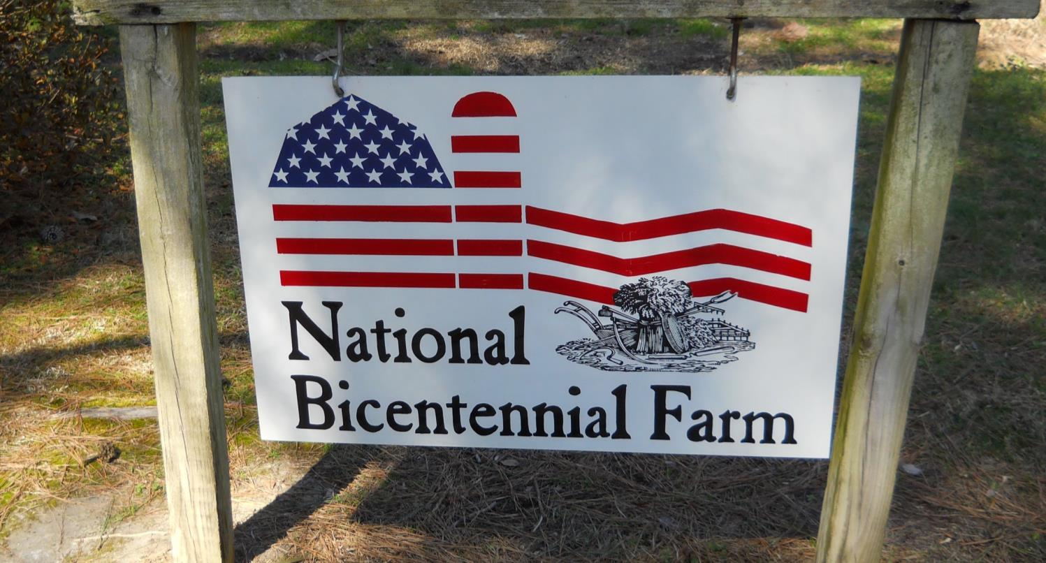

2018 Cotton Weed Management
Stanley Culpepper
UGA Extension
Tifton, GA

Slide 2
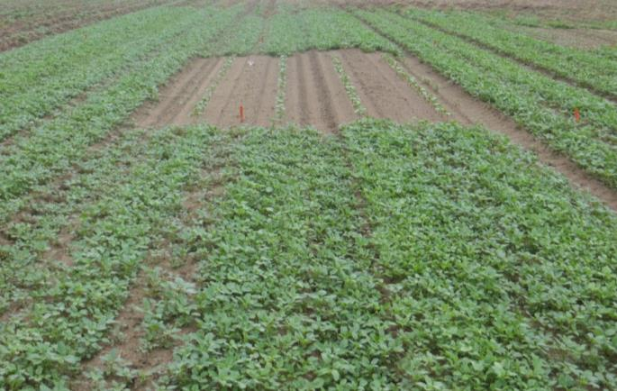
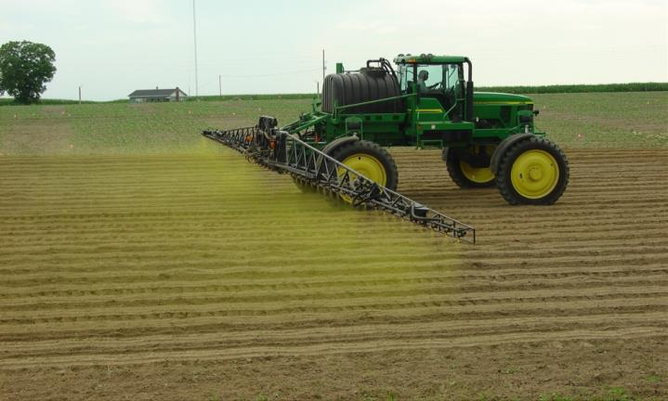
Auxin Technologies
WEED MGMT
STEWARDSHIP

Slide 3
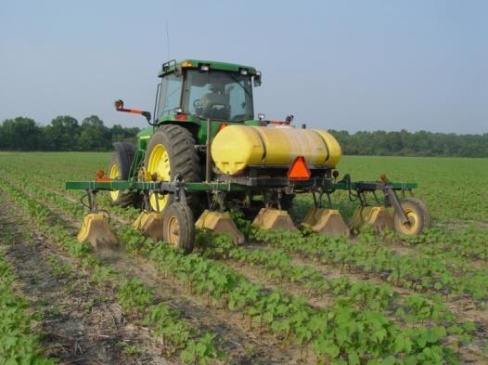
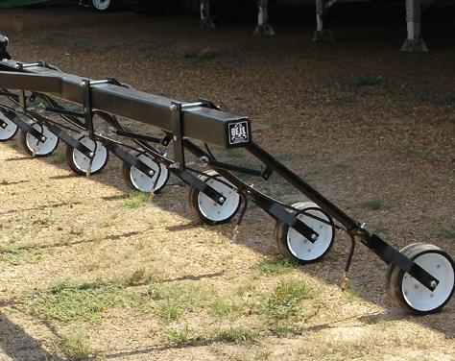
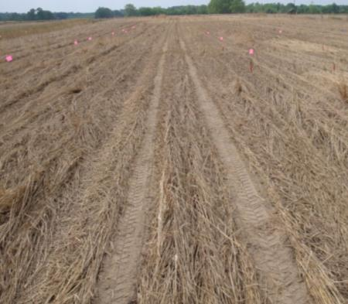
Weed Management Programs
Clean at planting
Preemergence application
Sequential Timely POST’s (most fields)
Layby…….key to our future

Slide 4
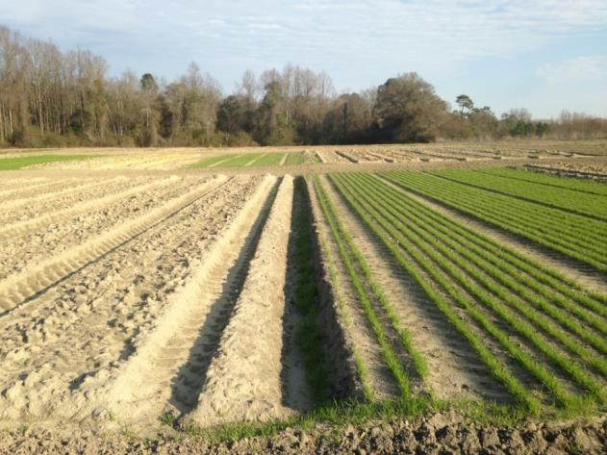
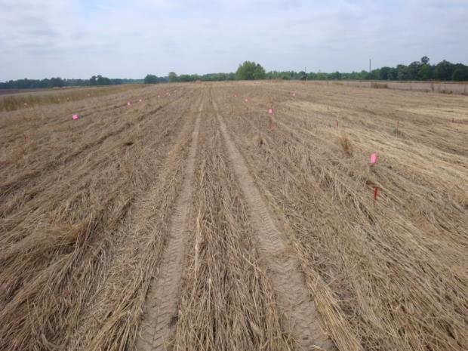
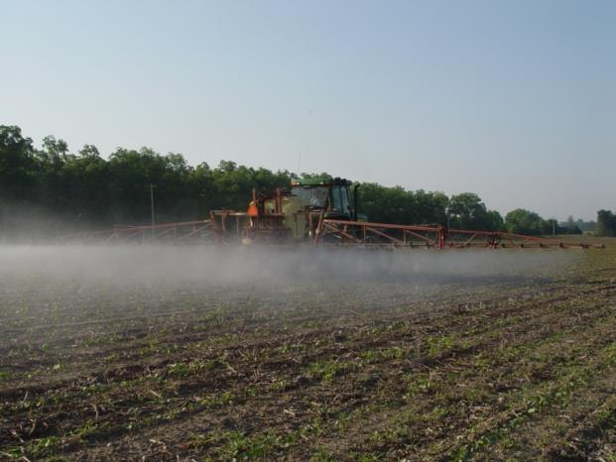
Auxin Systems – Clean At Planting
Tillage
Cover Crop
Burndown

Slide 5
Control of 3-7” Palmer Amaranth
94 a
%
61 c
Gramoxone
+ Direx
+ COC
RU +
Clarity
C52-15. Gramoxone, Direx, COC, & Wmax = 1 qt/A; Clarity 16 oz/A.

Slide 6
Burndown: 2,4-D vs Dicamba When Mixed with Roundup
Horseweed
Primrose
Radish
Cost
Plantback
2,4-D
+
++
++
++
+ 2,4-D
dicamba
++
+
+
+
+ dicamba

Slide 7
Burndown: 2,4-D vs Dicamba When Mixed with Roundup
Horseweed
Primrose
Radish
Cost
Plantback
2,4-D
?
+
+
+
?
dicamba
+
-
-
-
?
New formulations allow application to respective cultivars at any point before planting.

Slide 8
Burndown: 2,4-D vs Dicamba When Mixed with Roundup
Horseweed
Primrose
Radish
Cost
Plantback
2,4-D
?
+
+
+
?
dicamba
+
-
-
-
?
BAD IDEA – kill at least 10 d in advance….exception is cereal grains
New formulations allow application to respective cultivars at any point.

Slide 9
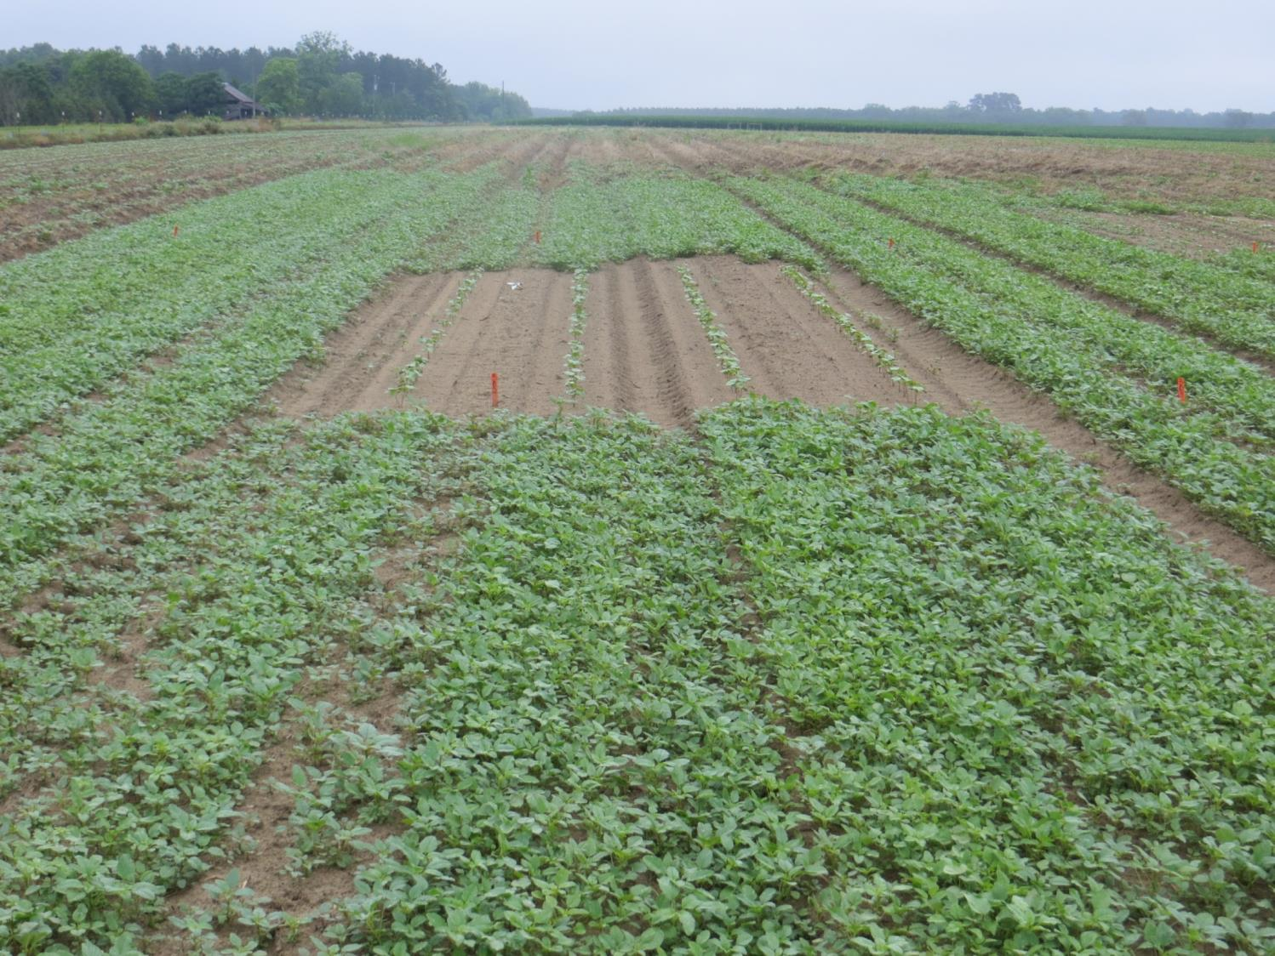
Auxin Systems – PRE REQUIRED
Resistance management!!!!!
Coverage
Early-season competition
Need no injury concern, low cost ($9.18 without reward)

Slide 10
Number of emerged Palmer amaranth/A at 21 d.
# of Palmer per acre
55,510
ab
39,650 bc
26,840 c
4270 c
4575 c
2440 c
Reflex
16 oz
Direx
16 oz
Warrant
48 oz
Reflex
12 oz
+
Direx
12 oz
Reflex
12 oz
+
Warrant
32 oz
Direx
12 oz
+
Warrant
40 oz
The non-treated control consisted of 1,464,000 per acre; LSD 21 K;

Slide 11
Auxin Systems
Clean at planting
PRE Required
Sequential POST’s……..
Layby:

Slide 12
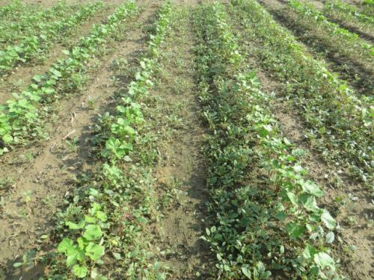
Number of Palmer Amaranth Per Acre as Influenced by Roundup + Dicamba
435,000
145,000
6534
No-POST
RU + dicamba
RU + dicamba
twice
Roundup PowerMax 1 qt/A; dicamba 0.5 lb ai/A.

Slide 13
Number of Palmer amaranth Per Acre as Influenced by Roundup + Dicamba
435,000
145,000
6534
No-POST
RU + dicamba
RU + dicamba
twice
A Liberty + Residual followed by RU + Dicamba is also very effective if a little more timely!!!
Roundup PowerMax 1 qt/A; dicamba 0.5 lb ai/A.

Slide 14

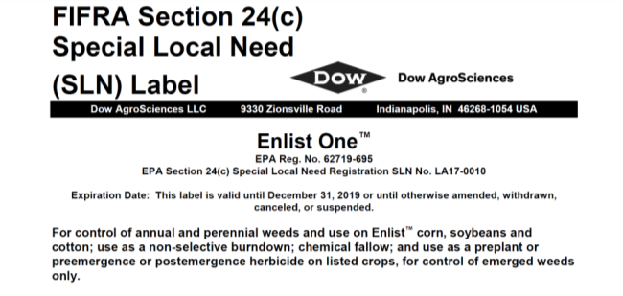
TANK MIXTURES:
numerous glufosinates
numerous glyphosates
Dual Mag
Warrant
Valor
Direx
Staple????

Slide 15

Layby..critical to FARM sustainability!!
For Palmer: Direx + MSMA; add Envoke or dicamba for MG.
If grasses: Roundup + Direx; add Envoke or dicamba for MG.

Slide 16
Overtop or Directed Layby? Year 1!
Palmer Control
100 a
95 b
%
1684 plant/A**
0 plant/A
RU + dicamba
RU + dicamba
RU + Direx
RU + dicamba
RU + dicamba
RU + dicamba
Warrant + Direx PRE; **No plants visible outside of the plot area; 363,000 plants per acre in control.

Slide 17
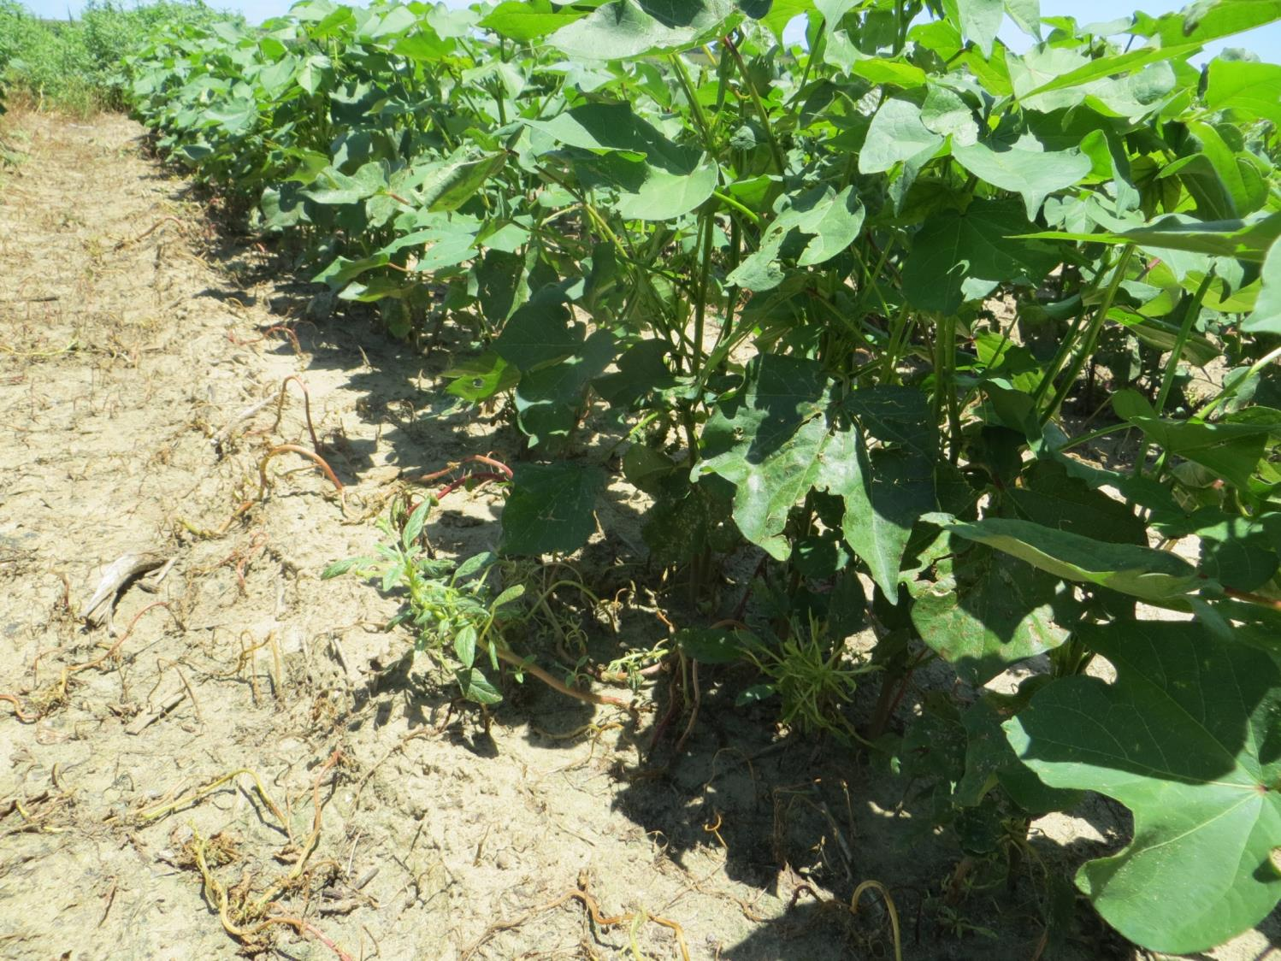
Year 2!

Slide 18
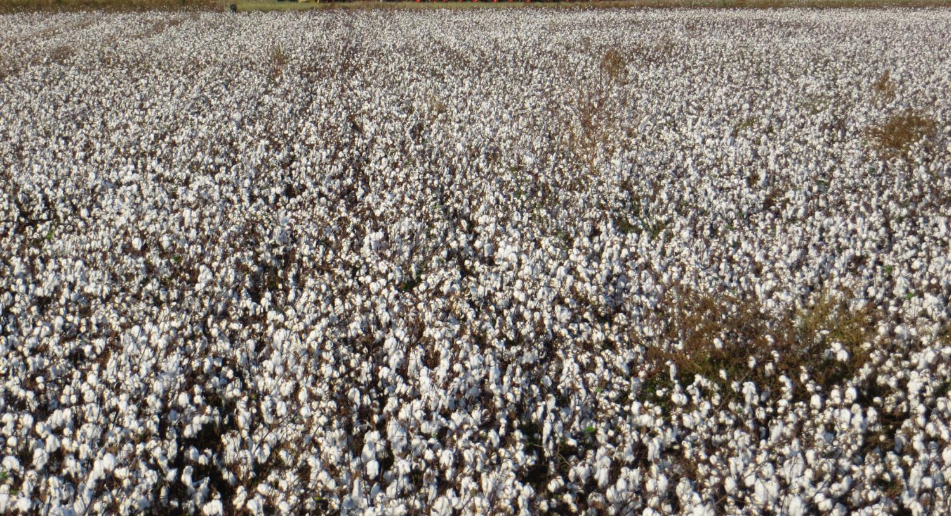
Large Acreage – Photo After Year 3!
Direx + Warrant PRE
RU + dicamba
RU + dicamba
RU + Direx
Direx + Warrant PRE
RU + dicamba
RU + dicamba
RU + dicamba

Slide 19
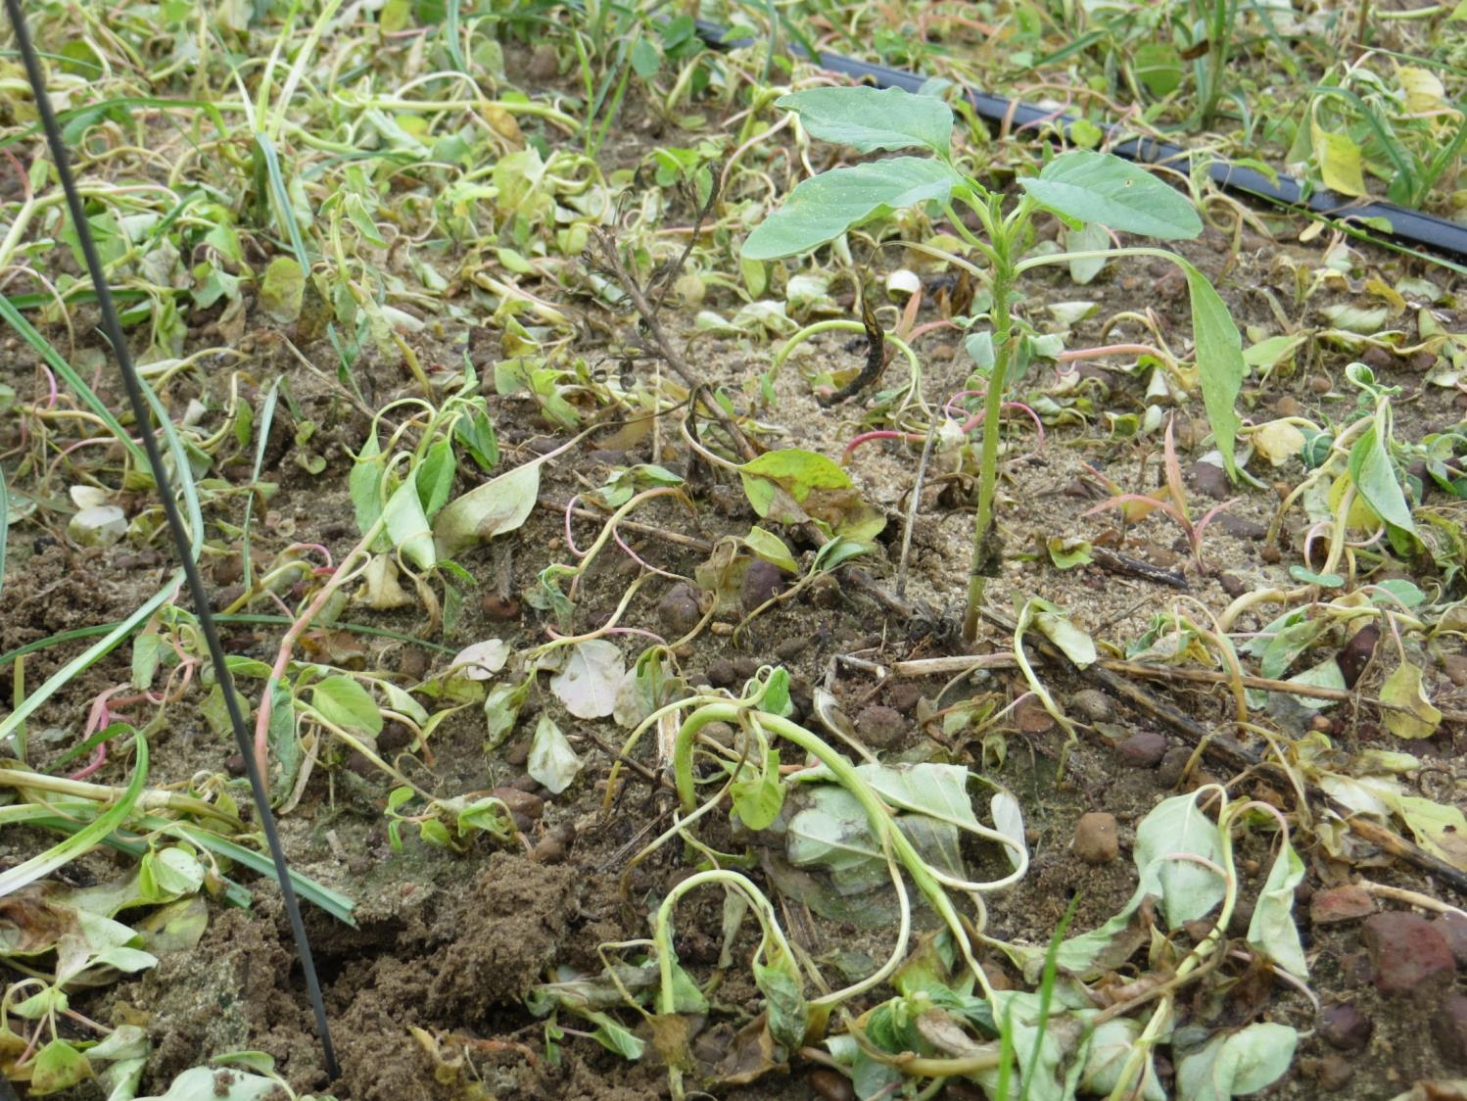

Slide 20


Dicamba – Engenia, FeXapan, XtendiMax
STEWARDSHIP

Slide 21
DICAMBA STEWARDSHIP
Label Changes – XtendiMax, Engenia, FeXapan
1. Restricted Use Pesticide
Sunrise to Sunset
Wind 3-10 mph
4. Documentation
5. Training

Slide 22


STEWARDSHIP: Restricted Use Pesticide
New products: critical to manage volatility
XtendiMax™ with Vapor Grip Technology™
Engenia™

Slide 23
Layby..critical to FARM sustainability!!
For Palmer: Direx + MSMA; add Envoke or dicamba for MG.
If grasses: Roundup + Direx; add Envoke or dicamba for MG.

Slide 24
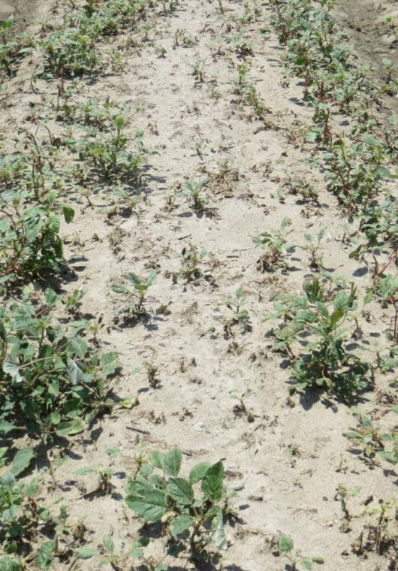
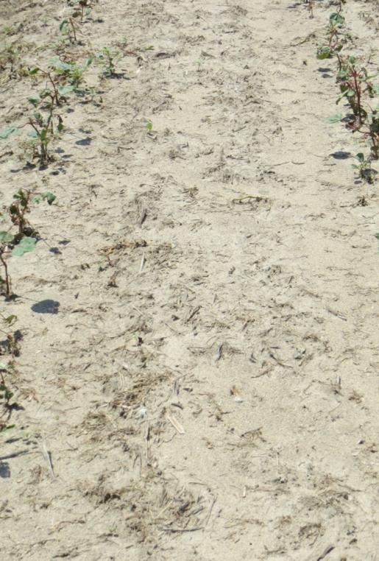
DICMABA STEWARDSHIP: Sunrise to Sunset
Roundup + dicamba
5:00 AM
8:00 AM

Slide 25
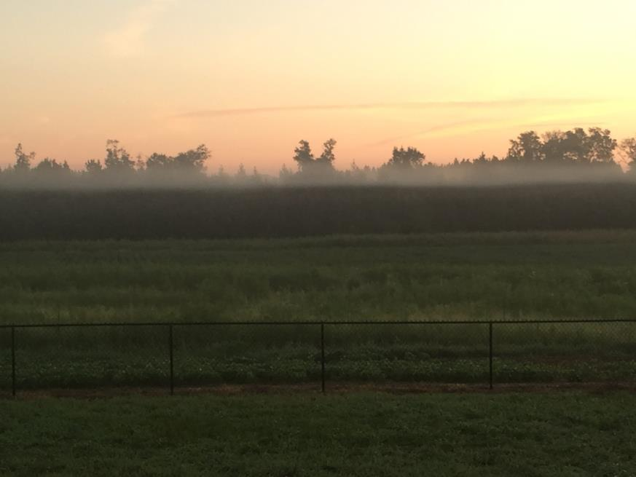
DICMABA STEWARDSHIP: Sunrise to Sunset
MUST AVOID spraying into inversions!!

Slide 26
UGA’s 15 Factors Influencing Success
Spray Tip
Wind
Size
of Crop
Spray Pressure
Land Terrain
Buffers
Sprayer Speed
Temp/Humidity
Boom Height
Herbicide Footprint/ Surrounding crops
Tank Cleanout
Drift Control Agent
Volatility
Proper Formulation
Residue Tolerance

Slide 27
DICAMBA STEWARDSHIP: Documentation
Full name
Certification number
Product name
EPA registration number
Total amount applied
Application, date
Location
Crop treated
Area treated
Training requirement
11. Application method
12. Sensitive crop awareness
13. Receipt of purchase
14. Product label
15. System cleanout
16. Tank Mix products
17. Start and finish times
18. Nozzle selection
19. Air temp
20. Wind speed and direction
Standardized form approved by GDA provided

Slide 28
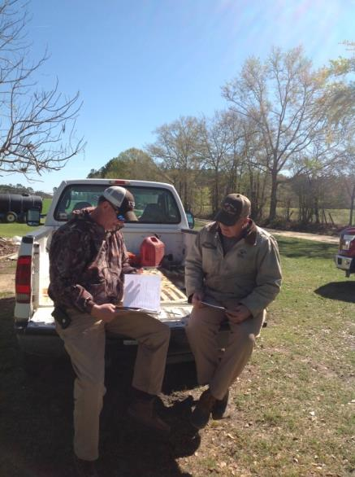
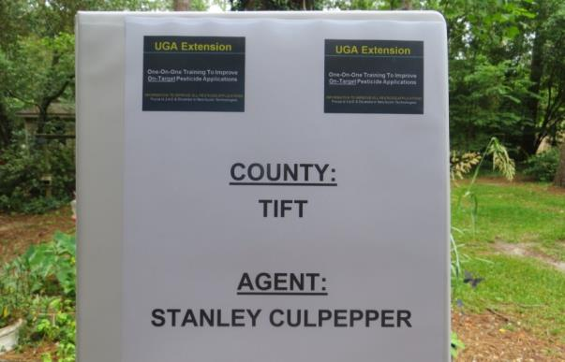
DICAMBA STEWARDSHIP: Training
Applicators must be trained prior to spraying Engenia, XtendiMax, or FeXapan.

Slide 29
DICAMBA STEWARDSHIP: Training
Applicators In Georgia: two options
UPW Classroom Training…..card.
UPW Agent One-On-One Training ..certificate.

Slide 30
DICAMBA STEWARDSHIP: Training
Applicators In Georgia: two options
UPW Classroom Training…..card.
UPW Agent One-On-One Training ..certificate.
Person in charge of application in Georgia
UPW Classroom Training…..card.

Slide 31
UPW Classroom Training
Bulloch Co.: March 19
Burke Co.: March 19
Mitchell Co.: March 21
Peach Co.: March 23
Calhoun Co.: March 28
Tift Co.: April 4
Laminated Handouts
Cotton
Cole Crop
Mulch fumigation
Sensitive Crops
Squash
Sweet potato
Watermelon

Slide 32
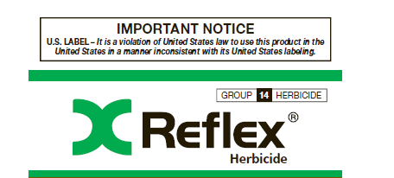
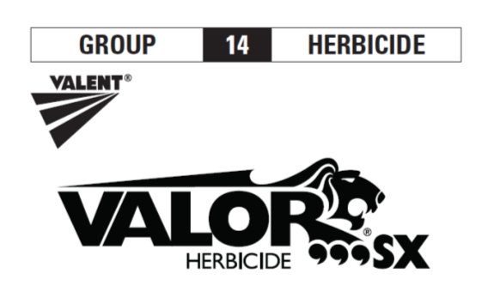







Commonly Used PPO’s

Slide 33
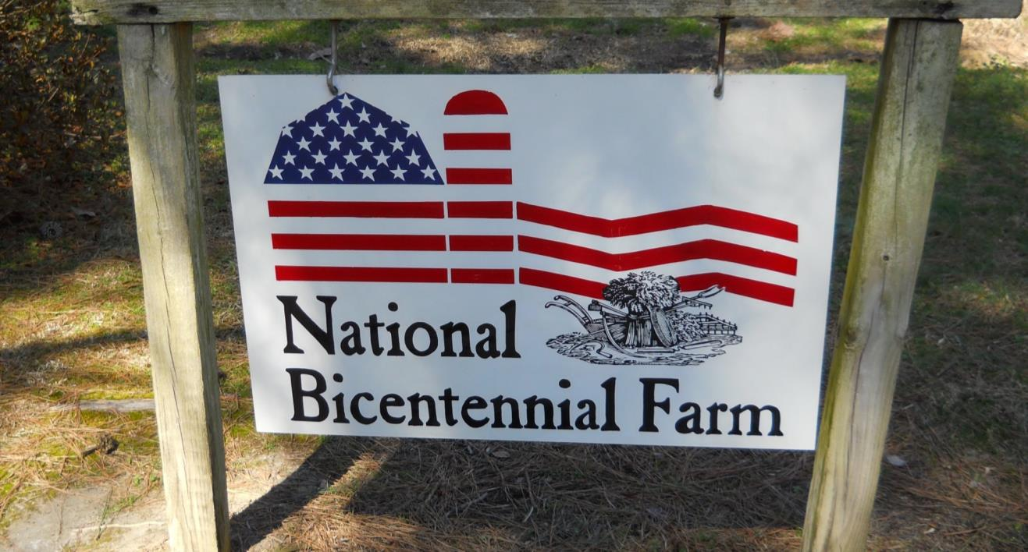
Fill out survey if auxin technology is important to you!
Stanley Culpepper
UGA Extension
Tifton, GA

